Slide 1
PLAYER PERFORMANCE CLASSIFICATION WITH FEATURE SELECTION AND PCA
İshak Orçun Aydemir
Utku Özyiğit

Slide 2
player_stats.csv
Our objective is to classify players based on the "rating" variable using a balanced dataset. To better understand the dataset and optimize the modeling process, we applied the following methods:
-Random Forest Feature Importance (for feature selection)
-PCA (Principal Component Analysis) for dimensionality reduction
-Logistic Regression as the classification model

Slide 3
FEATURE SELECTION
Feature selection was performed to reduce the complexity of our model and improve training time. Since our dataset contains a limited number of numerical variables, the importance scores were analyzed based on the following key features: kd_diff, kd, total_rounds, and total_maps.

Slide 4
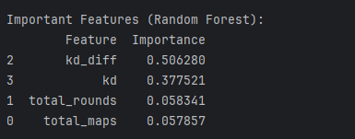
RANDOM FOREST FEATURE IMPORTANCE
Since the Random Forest model is a tree-based algorithm, it is effective in measuring the predictive power of features. According to the results, kd_diff and kd emerged as the most critical features for classification. The rating variable is either not a numerical value (or was not used in classification) or was excluded naturally since it is the target variable, and therefore it does not appear among the features.

Slide 5
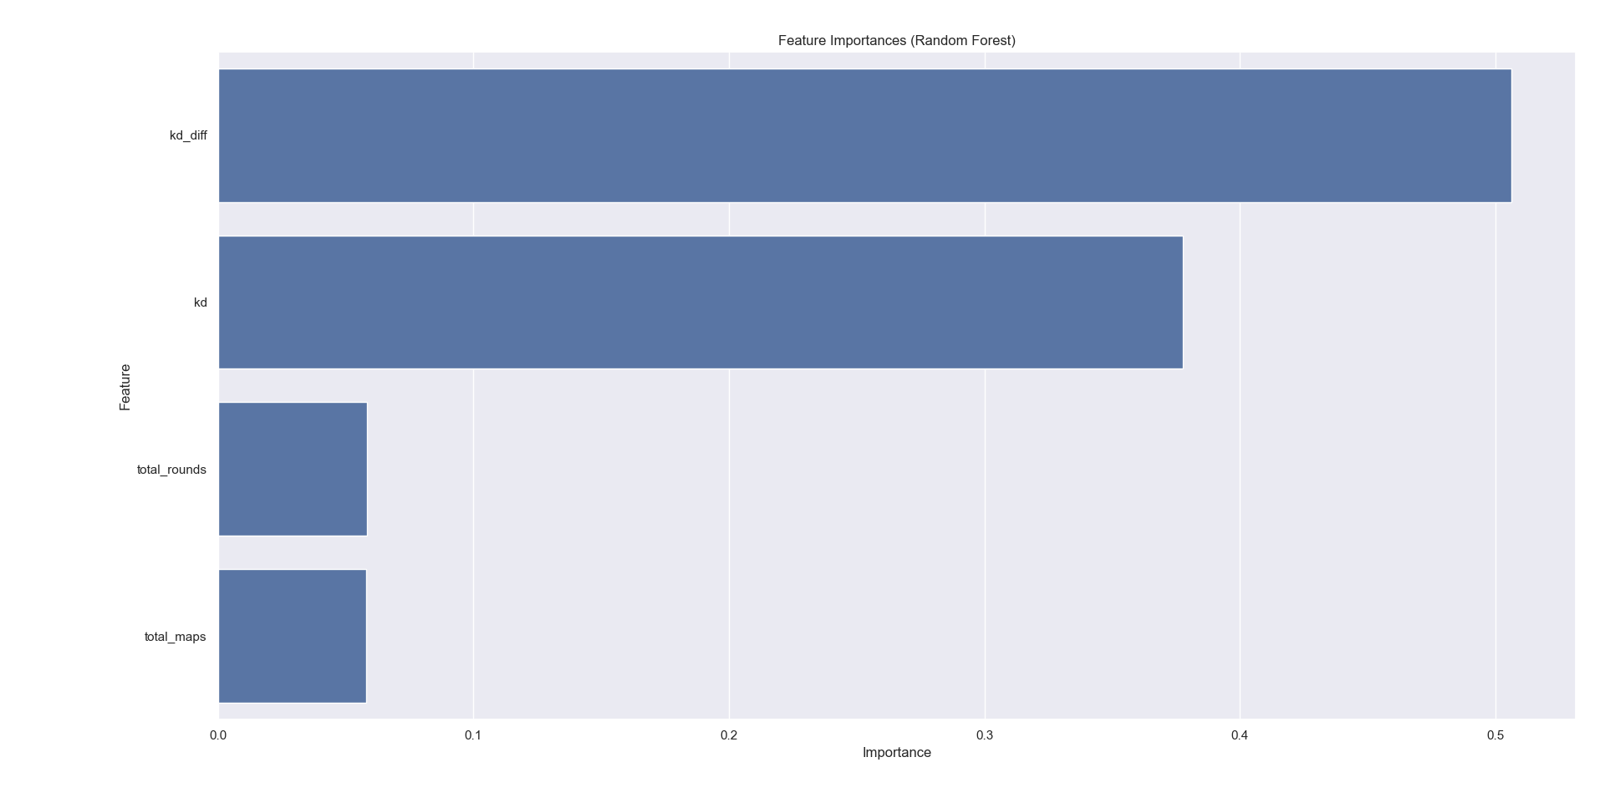

Slide 6
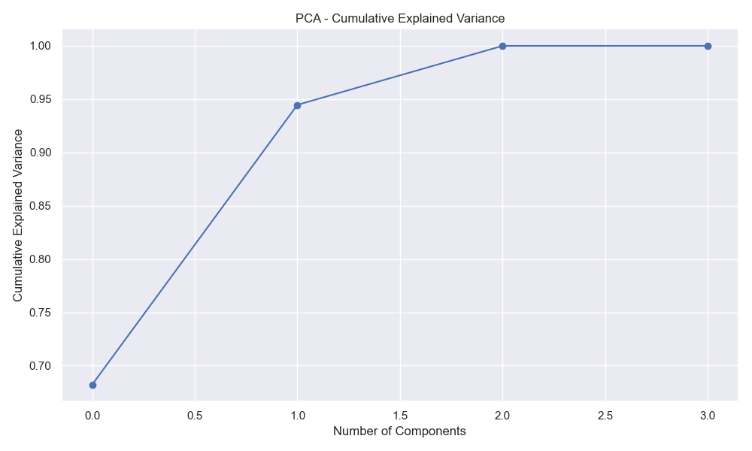
PCA (WHAT IT IS, RESULTS, AND PERFORMANCE)
This graph shows the cumulative explained variance of the PCA components in the dataset. The first four components explain a large portion of the total variance (e.g., over 95%), indicating that dimensionality reduction results in minimal information loss. This allows us to perform classification more quickly and effectively using fewer features.

Slide 7
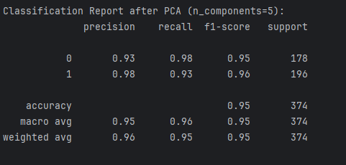
The model achieved 95% accuracy. Precision and recall scores are high for both classes, indicating strong performance in distinguishing between them.

Slide 8
THANKS FOR LISTENING

